Slide 1
Computer Science and Engineering with Data Science(CSD)
Mini Project (2024-2025)
IV B.Tech I Semester
ML-Driven Customer Segmentation
Project Guide:
Project Team :
Bandra Anusha (21E51A6704)
Adithya chilupuri (21E51A6707)
Thakur Aryan Singh (21E51A6760)
V.Ramesh (21E51A6762)
Mr.Nava Kishore

Slide 2
Abstract
Customer segmentation has become a popular method for dividing a company's customers to enhance retention and profitability. In this study, customers from various organizations are classified based on behavioral characteristics such as spending an income. By focusing on these behavioral aspects, the classification methods become more efficient compared to others. Utilizing the clustering algorithm, customers are grouped based on their behavioral traits. These clusters enable companies to target individual customers effectively, tailoring marketing campaigns and social media content to their interests. In this project, We will perform unsupervised clustering on customer records from a grocery firm's database. Customer segmentation involves grouping customers to reflect similarities within each cluster. This segmentation optimizes the significance of each customer to the business, allowing for product modifications to meet distinct needs and behaviors. It also helps address the concerns of different types of customers, enhancing overall business strategy

Slide 3
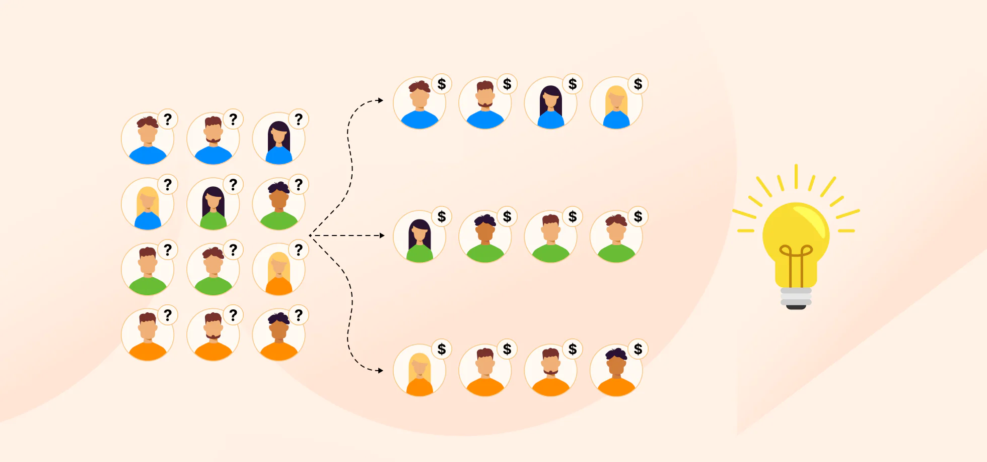
Introduction
In this project, We will be performing an unsupervised clustering of data on the customer's records from a groceries firm's database. Customer segmentation is the practice of separating customers into groups that reflect similarities among customers in each cluster. I will divide customers into segments to optimize the significance of each customer to the business. To modify products according to distinct needs and behaviours of the customers. It also helps the business to cater to the concerns of different types of customers.

Slide 4
Literature Survey
1.Customer Segmentation Using K-Means Clustering
This paper discusses the use of the K-means algorithm for segmenting customers based on purchasing behaviors. It provides a detailed case study and analysis of the segmentation process and its effectiveness in improving marketing strategies
https://link.springer.com/chapter/10.1007/978-981-19-9228-5_38
2. Application of K-Means Algorithm for Efficient Customer Segmentation
This paper highlights how K-means clustering is applied for targeted customer services by segmenting customers based on purchase behavior and other factors.
https://iopscience.iop.org/article/10.1088/1757-899X/336/1/012017

Slide 5
Literature Survey
3.Customer Segmentation in XYZ Bank Using K-Means and K-Medoids Clustering
This case study investigates customer segmentation techniques applied in the banking industry using both K-means and K-medoids clustering methods.
https://ieeexplore.ieee.org/document/8528086
4.Customer Segmentation Using Hierarchical Agglomerative Clustering
Customer segmentation using hierarchical agglomerative clustering involves iteratively merging customers based on their similarity until all are grouped into clusters, allowing businesses to target specific customer behaviors. This method helps in visualizing customer relationships through dendrograms, making it easier to understand the hierarchy of clusters formed.
https://dl.acm.org/doi/abs/10.1145/3322645.3322677

Slide 6
Dataset Overview
People
ID: Unique customer identifier
Year_Birth: Customer's birth year
Education: Education level
Marital_Status: Marital status
Income: Yearly household income
Kidhome: No. of children in household
Teenhome: No. of teenagers in household
Dt_Customer: Enrollment date
Recency: Days since last purchase
Complain: Filed a complaint (1/0)
Products
MntWines, M&t Fruits, Mtn Meat Products
MintFish Products, Mint Sweet Products, MntGoldProds (Amounts spent in the last 2 years)
Promotions
Num Deals Purchases: No. of purchases with discount
Accepted Cmp1–5: Accepted campaign offers (1/0)
Response: Accepted last campaign offer (1/0)
Place
Num Purchases, Num Catalog Purchases, Num Store Purchases (No. of purchases via different channels)
NumWebVisitsMonth: Website visits last month

Slide 7
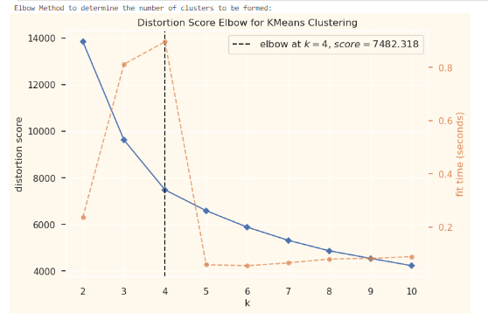
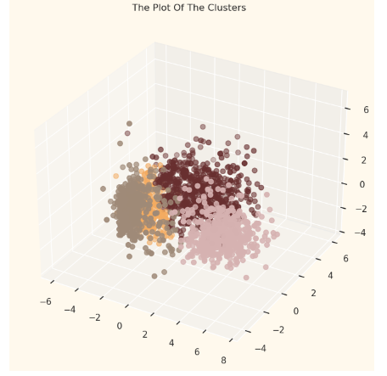
Model Implementation
1. Elbow Method:
Determines optimal number of clusters (k).
Identified 4 as the ideal number based on the distortion score plot.
2. Agglomerative Clustering:
Model initialized with 4 clusters.
Fitted to the PCA-reduced dataset.
Cluster labels assigned to both the PCA and original datasets.
3. Cluster Visualization:
3D scatter plot displays cluster distribution.
Points colored by cluster membership for clear visual differentiation.

Slide 8
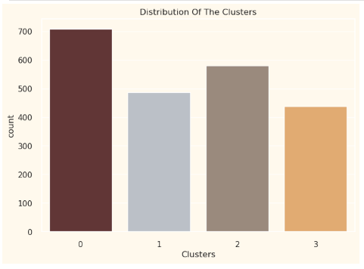
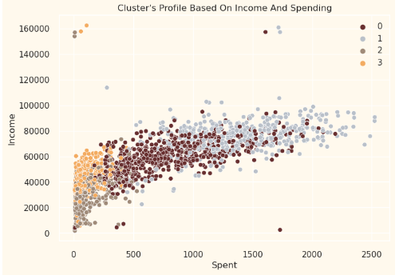
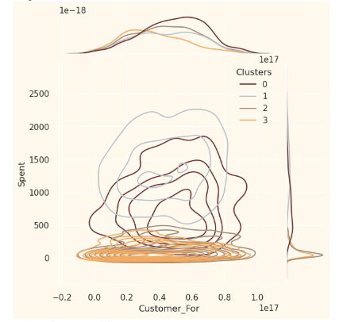
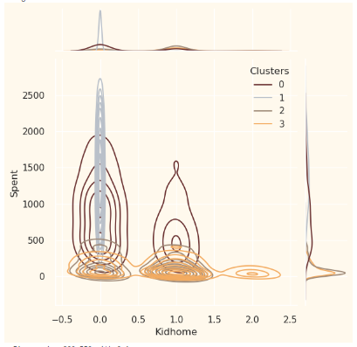
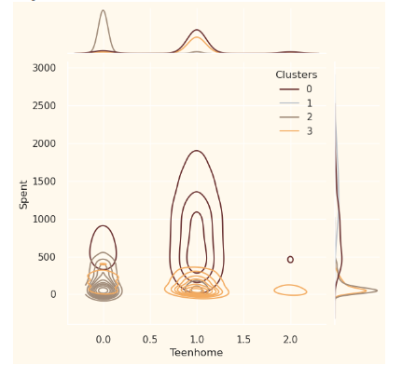
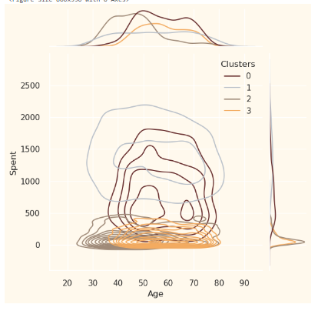
Results

Slide 9
Profiling
Customer Profiling by Cluster
Cluster Characteristics:
Cluster 0:
Majority are parents, including single parents
Family size: 2-4 members
Most have teenagers
Relatively older customers
Cluster 1:
Non-parents; family size max of 2
Majority are couples
Spans all age groups
High-income group
Cluster 2:
Mostly parents with young children (not teenagers)
Family size: up to 3 members
Relatively younger customers
Cluster 3:
All are parents; family size 2-5 members
Majority have teenagers
Relatively older customers
Lower-income group

Slide 10
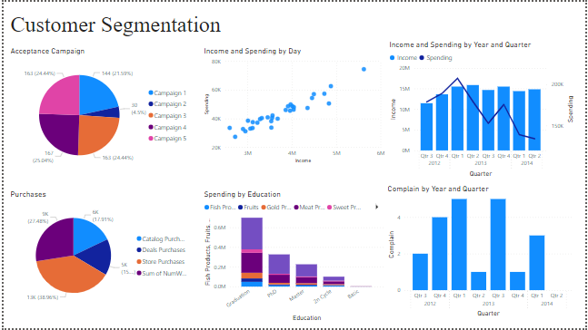
Dashboard

Slide 11
CONCLUSION
The customer profiling analysis provides valuable insights into the distinct characteristics of each cluster, facilitating the development of targeted marketing strategies:
Cluster 1 represents our star customer segment, characterized by high-income, non-parents. Prioritizing this group for premium offerings and exclusive promotions can drive significant revenue growth.
Cluster 0, comprised of older parents with teenagers, presents opportunities for family-oriented marketing initiatives that cater to their specific needs and preferences.
Cluster 3 consists of lower-income parents, indicating a need for affordable product offerings and support programs to enhance their shopping experience and foster loyalty.
Cluster 2, featuring younger parents with young children, reveals potential for targeted marketing focused on early childhood products, supporting their developmental needs.
By leveraging these insights, the marketing team can implement tailored strategies that resonate with each customer segment, ultimately enhancing engagement, increasing customer satisfaction, and driving overall sales growth.

Slide 12
THANK YOU

Slide 13
Data Cleaning
Missing Values: Dropped 1.07% rows with missing Income values, reducing the dataset from 2240 to 2216 records.
Datetime Parsing: Converted Dt_Customer to datetime format; calculated Customer_For (days since registration) based on the most recent date (2014-12-06).
Feature Engineering:
Age: Derived from Year_Birth.
Spent: Total spending across all categories.
Living_With: Simplified marital status into "Partner" or "Alone".
Children & Family_Size: Combined Kidhome and Teenhome.
Is_Parent: Indicator for parenthood.
Education: Simplified into "Undergraduate," "Graduate," and "Postgraduate".
Outliers: Removed records with Age > 90 and Income > 600,000. Final dataset: 2212 records.
Dropped Features: Removed redundant columns (ID, Year_Birth, etc.).

Slide 14
Data Preprocessing
Label Encoding: Transformed categorical variables (Education, Living_With) into numerical values for model compatibility.
Feature Scaling: Applied StandardScaler to standardize features, ensuring a mean of 0 and standard deviation of 1 for uniformity.
Subset Creation: Created a subset dataframe by dropping promotional columns (Accepted Cmp1-5, Complain, Response) to focus on customer demographics.
Dimensionality Reduction Preparation: Prepared the scaled dataframe for clustering, retaining critical features like Income, Recency, Wines, and Family_Size.

Slide 15
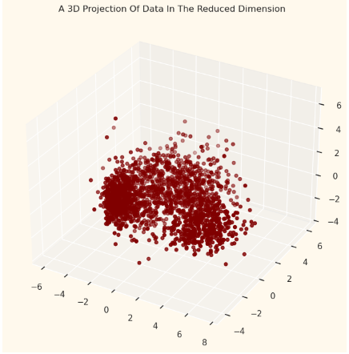
Dimensionality Reduction
Objective: Simplify high-dimensional data to enhance interpretability while minimizing information loss.
Method: Principal Component Analysis (PCA)
Transforms original features into a new set of orthogonal components.
3D Visualization:
Plot the reduced dataset in 3D space:

